Slide 1
Reporting Requirements of SAE in India
Manasi Dhamal
Arti Yadgire
Akshata Chandak

Slide 2
Content
What is Adverse Event (AE)?
What is Serious Adverse Event (SAE)?
Timeframe for Initial SAE Report submission
Flowchart for SAE Reporting/Monitoring
Process flow for SAEs Reporting
Data Elements for Reporting SAEs
Demo

Slide 3
What is Adverse Event (AE)? _{[1]}
Any untoward medical occurrence in a patient or clinical investigation subject administered a pharmaceutical product and which does not necessarily have a causal relationship with this treatment.
An AE can therefore be any unfavorable and unintended sign (including an abnormal laboratory finding), symptom, or disease temporally associated with the use of a medicinal (investigational) product, whether or not related to the medicinal (investigational) product.
[1] ICH-GCP E6(R2) – 1.2

Slide 4
What is Serious Adverse Event(SAE)? (1/3) _{[2]}
Serious Adverse Event (SAE) : Any untoward medical occurrence that at any dose –
Results in death
Is life-threatening
Requires inpatient hospitalization or prolongation of existing hospitalization
Results in persistent or significant disability/incapacity
Is a congenital anomaly/birth defect
[2] ICH-GCP E6(R2) – 1.50

Slide 5
What is Serious Adverse Event(SAE)? (2/3) _{[3]}
Important Medical Event (IME) that may not result in death, be life threatening, or require hospitalization may be considered a serious adverse drug experience when, based upon medical judgment, it may jeopardize the patient or subject and may require medical or surgical intervention to prevent one of the outcomes listed in this definition.
It is important to remember that all SAEs are adverse events, but not all adverse events are SAEs
[3] SAE User Manual – 1.1

Slide 6
What is Serious Adverse Event(SAE)? (3/3) _{[3]}
“Life Threatening Adverse Drug Experience” :- Any adverse experience that places the subject, in the view of the investigator, at immediate risk of death from the reaction as it occurred, or it is suspected that the use or continued use of the product would result in the patient’s death.
“Congenital Anomaly” :- Exposure to a medical product prior to conception or during pregnancy resulting in an adverse outcome in the child.
[3] SAE User Manual – 1.1

Slide 7
Timeframe for Initial SAE Report submission (1/2) _{[4]}
The investigator shall report all serious adverse events to the Central Licensing Authority (CDSCO), the sponsor or its representative and the Ethics Committee within twenty-four hours of their occurrence and after due analysis to the Central Licensing Authority, Ethics Committee and the head of the institution within fourteen days of the knowledge of occurrence of serious adverse event.
The sponsor or its representative shall report all serious adverse events to the Central Licensing Authority (CDSCO), head of the institution and Ethics Committee within fourteen days of the knowledge of occurrence of serious adverse event.
[4] SAE User Manual – 1.2.1

Slide 8
Timeframe for Initial SAE Report submission (2/2) _{[4]}
The Ethics Committee shall forward its report on serious adverse event within a period of thirty days of receiving the report of the serious adverse event from the investigator.
[4] SAE User Manual – 1.2.1

Slide 9
Recipients of SAEs Reports _{[5]}
Site Principal Investigators (PI), who confirmed that SAEs occurred in their trial, are required to report the SAEs to CDSCO and also to their Trial Sponsor and Ethics Committees.
[5] SAE User Manual – 1.2.2

Slide 10
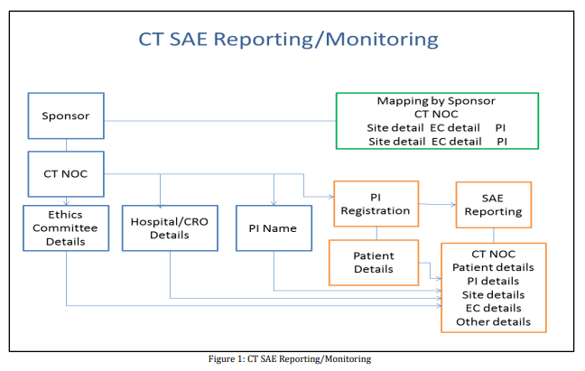
Flowchart for SAE Reporting/Monitoring _{[6]}
[6] SAE User Manual

Slide 11
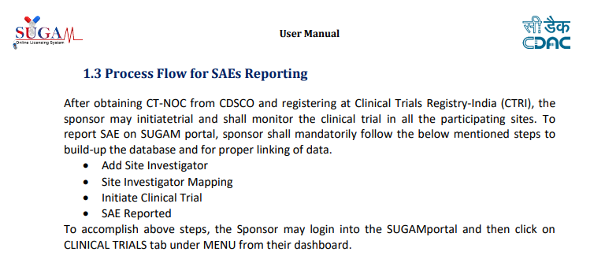
Process flow for SAEs Reporting _{[7]}
[7] SAE User Manual – 1.3

Slide 12
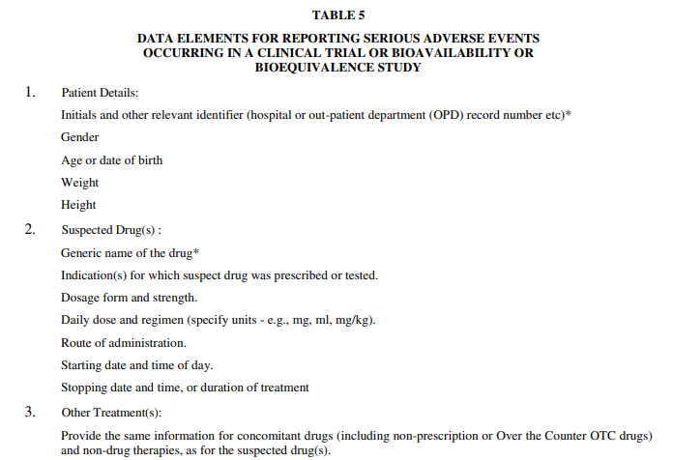
Data Elements for reporting SAE (1/3) _{[8]}
[8] New Drugs and Clinical Trial Rules 2019 – Table 5

Slide 13
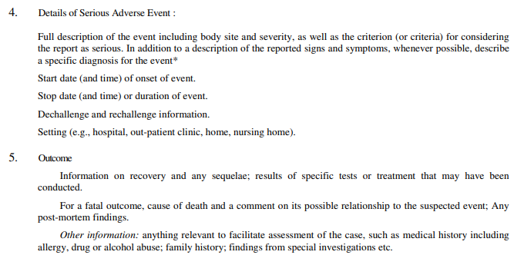
Data Elements for reporting SAE (2/3) _{[8]}
[8] New Drugs and Clinical Trial Rules 2019 – Table 5

Slide 14
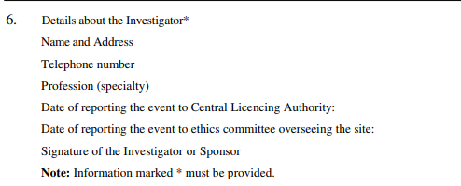
Data Elements for reporting SAE (3/3) _{[8]}
[8] New Drugs and Clinical Trial Rules 2019 – Table 5

Slide 15

Demo
https://cdscoonline.gov.in/CDSCO/homepage

Slide 16
References
ICH-GCP E6(R2)
CDSCO Website : https://cdscoonline.gov.in/CDSCO/homepage
New Drugs and Clinical Trial Rules 2019
SAE User Manual : https://cdscoonline.gov.in/CDSCO/resources/app_srv/cdsco/global/helpfiles/SAE_UserManual%20_(Online%20_&_Offline).pdf

Slide 17
THANK YOU! _{[5]}

